Slide 1

Analysis of Airline Profitability
<number>

Slide 2
Analytics Opportunity
Objective: Identify areas of the business that are most profitable, and least profitable. Assess the profitability potential of adding a new route from ORD-ATL.
Data sources recently made available:
Flights
Routes
Aircraft
Airports
<number>

Slide 3
Profitability and Revenue Findings
Most Profitable Assets
Routes
ORD-LAX
ORD-DCA
Aircraft
A319
Least Profitable Assets
Routes
ORD-SLC
ORD-MSP
Aircraft
B737
<number>

Slide 4
Route Analysis – Total Profit
The route bringing in the most total profit is the ORD-LAX route at $44,405,337.22
The route bringing in the least overall profit is the ORD-SLC route at $1,897,734.00
<number>

Slide 5
Route Analysis - Average Profit
The most profitable route on average is ORD-DCA at $910,711.58
Considerably higher than the next most profitable route ORD-SFO due to high average ticket price and low distance
The least profitable route on average is ORD-MSP at $21,102.76
Driven by low average ticket price
Route | AVG Profit | AVG Cost per Mile | AVG Ticket Price | Distance (miles)
ORD-DCA | $910,689.08 | $2.01 | $5,000.00 | 600.00
ORD-SFO | $67,005.98 | $2.00 | $375.00 | 1600.00
ORD-MSP | $21,093.72 | $2.00 | $115.00 | 300.00
<number>

Slide 6
Route Analysis - Distance vs Ticket Price
The ORD-DCA route has the highest average ticket price despite it’s relatively short distance
The ORD-MSP route has the second lowest average ticket price despite not having the shortest distance
Route | Distance (miles) | Average List Price
ORD-SFO | 1600 | $375.00
ORD-LAX | 1518 | $350.00
ORD-SEA | 1500 | $350.00
ORD-PHX | 1200 | $250.00
ORD-LAS | 1100 | $275.00
ORD-MIA | 1000 | $300.00
ORD-SLC | 1000 | $290.00
ORD-FLL | 940 | $300.00
ORD-MCO | 850 | $250.00
ORD-DEN | 800 | $300.00
ORD-IAH | 800 | $200.00
ORD-BOS | 730 | $300.00
ORD-CLT | 700 | $125.00
ORD-DFW | 700 | $200.00
ORD-JFK | 619 | $250.00
ORD-LGA | 610 | $275.00
ORD-DCA | 600 | $5,000.00
ORD-EWR | 600 | $225.00
ORD-PHL | 580 | $275.00
ORD-BWI | 520 | $240.00
ORD-IAD | 515 | $300.00
ORD-ATL | 510 | $200.00
ORD-MSP | 300 | $115.00
ORD-DTW | 200 | $115.00
<number>

Slide 7
Aircraft Analysis – Cost per Mile & Utilization
Flights on the A319 have the lowest average cost per mile at $1.91 per mile and make up 54.05% of the flights impacting profitability positively
Flights on the B737 aircraft have the highest cost per mile at $2.08 and make up 36.25% of the flights.
Increase profitability by decreasing the number of B737 flights and increase the number of A320 or A319
<number>

Slide 8
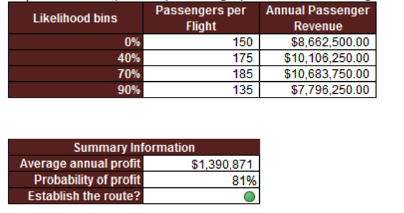
ATL Route Analysis
The ORD-ATL Route should be added
57% IRR
Likelihood of returning a profit is 81%
Average Annual Profit estimated at $1,390,871
<number>

Slide 9
Next Steps
Evaluate aircraft type and ticket pricing for least profitable routes ORD-SLC and ORD-MSP to increase profitability
Establish a route to ORD – ATL
<number>

Slide 10
Thank You!
<number>

